Slide 1


Slide 2


Slide 3


Slide 4
Arduino Uno
MQ-2 Smoke Sensor
Flame Sensor
16X2 I2C LCD Display
Buzzer
Breadboard
Battery Source
Jumper wires

Slide 5
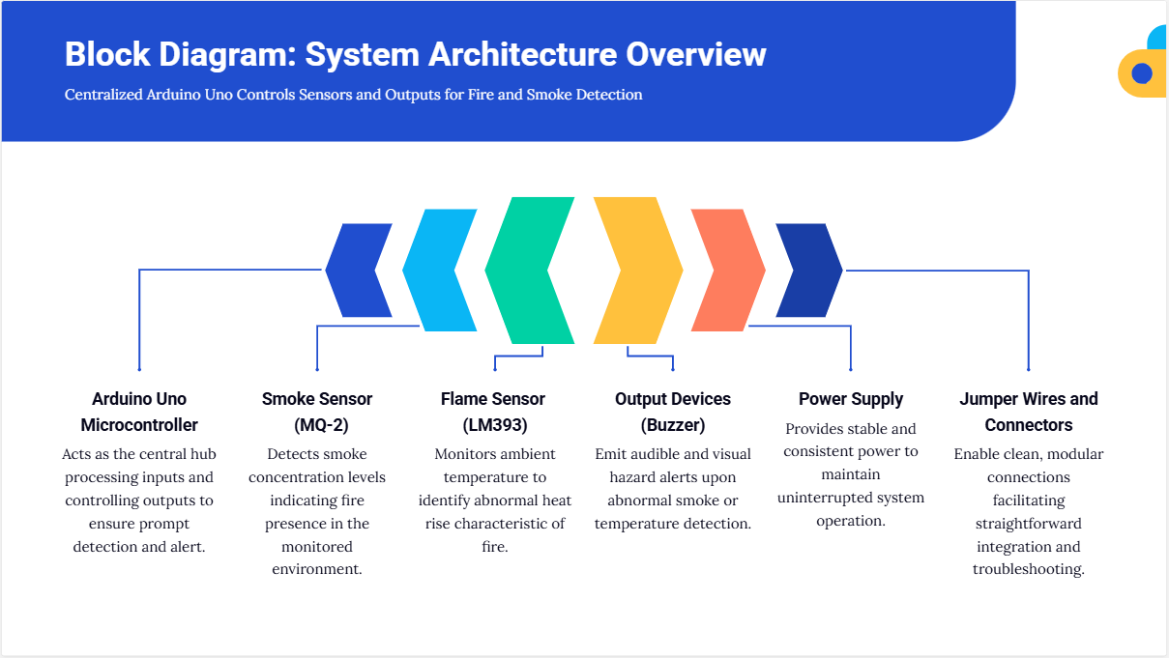

Slide 6
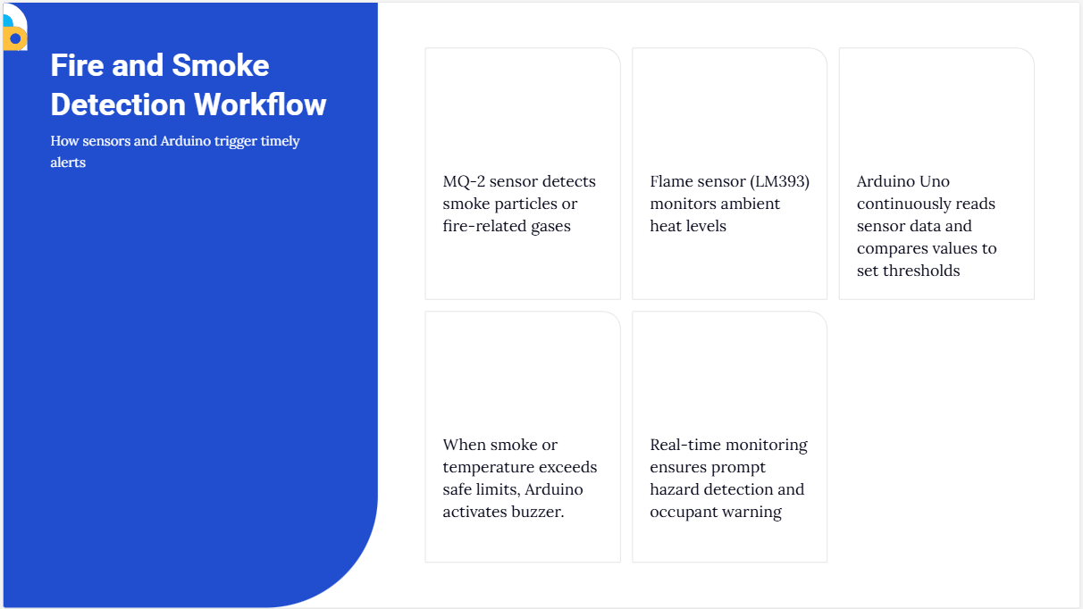

Slide 7
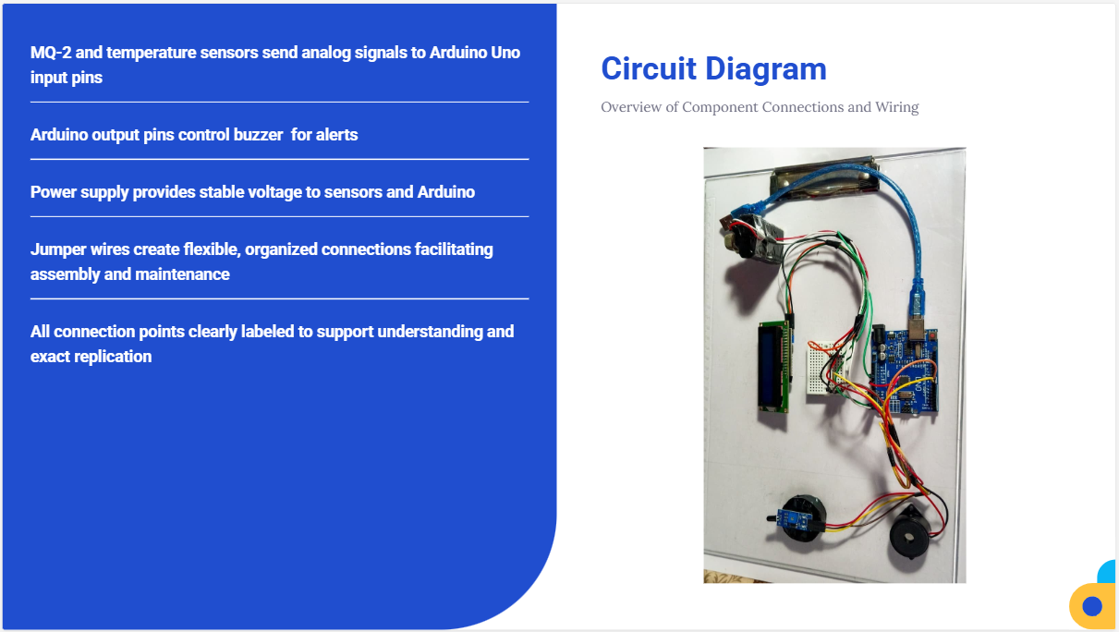

Slide 8
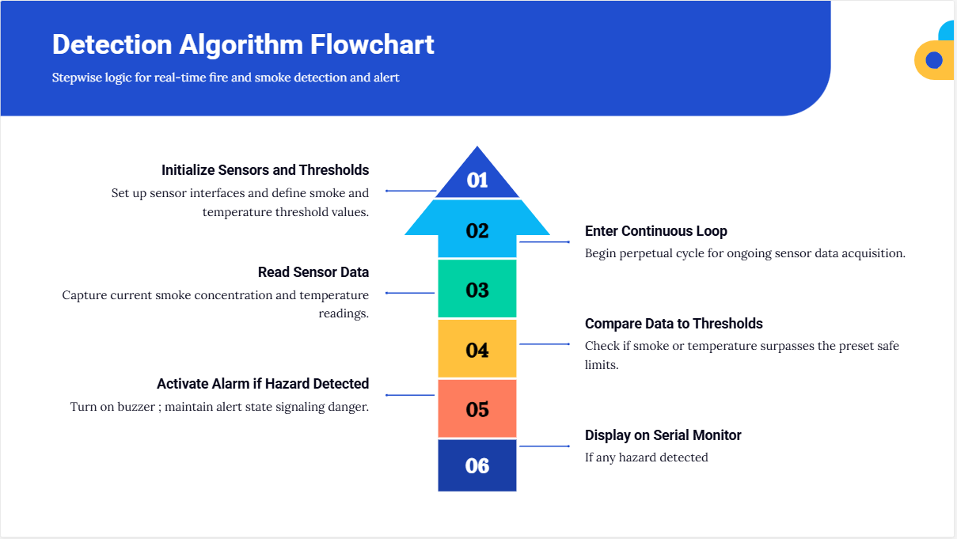

Slide 9


Slide 10


